Slide 1

House Price Prediction
Regression Techniques
Aniketh. S
W1607589

Slide 2
Train and test datasets - obtained from Kaggle
train.csv
test.csv
Check for missing values - dropna() and imputation strategies
Create numerical and categorical feature datasets
Study the

Slide 3
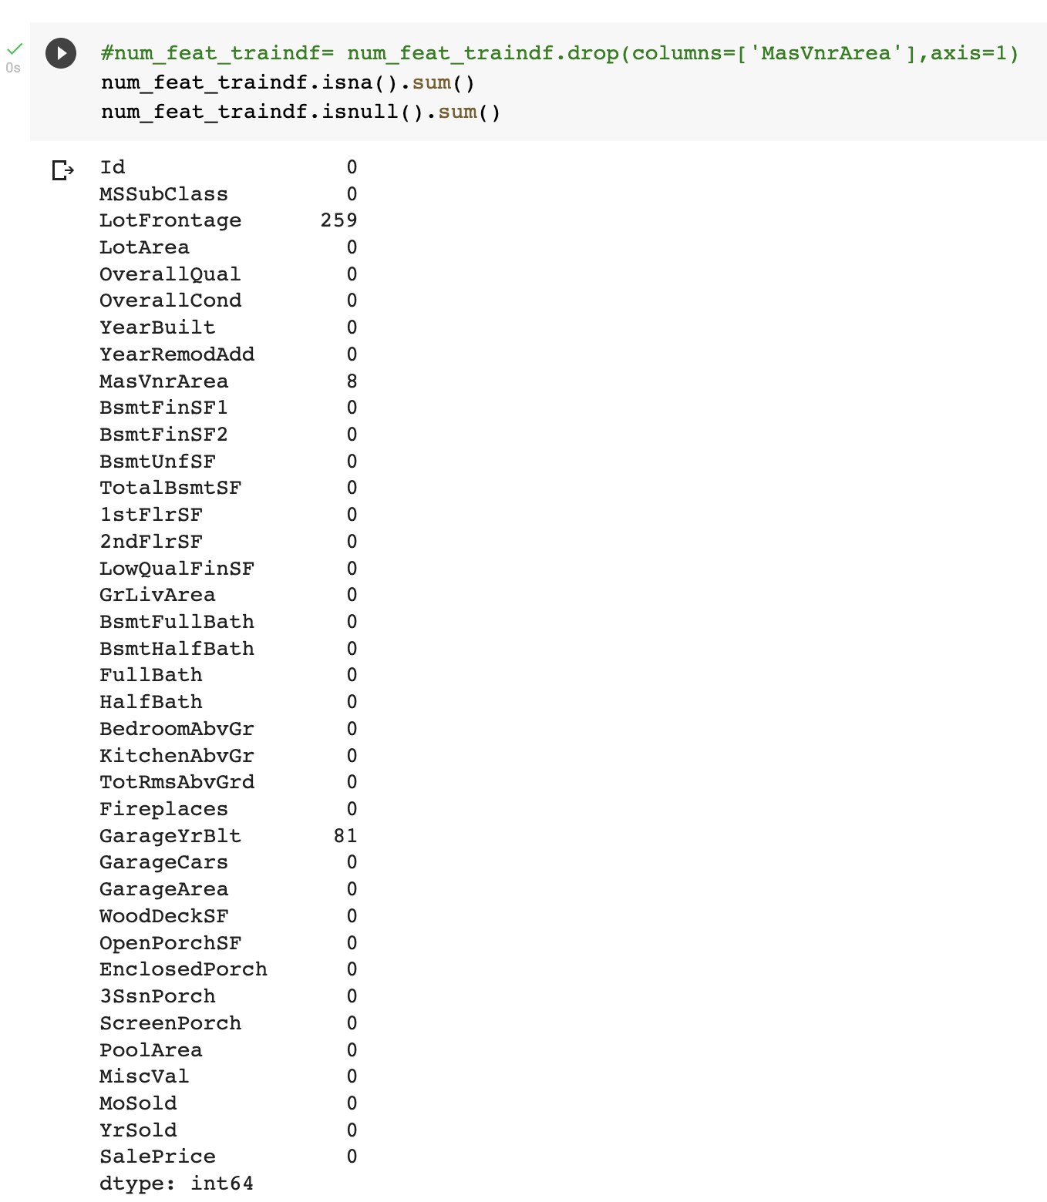
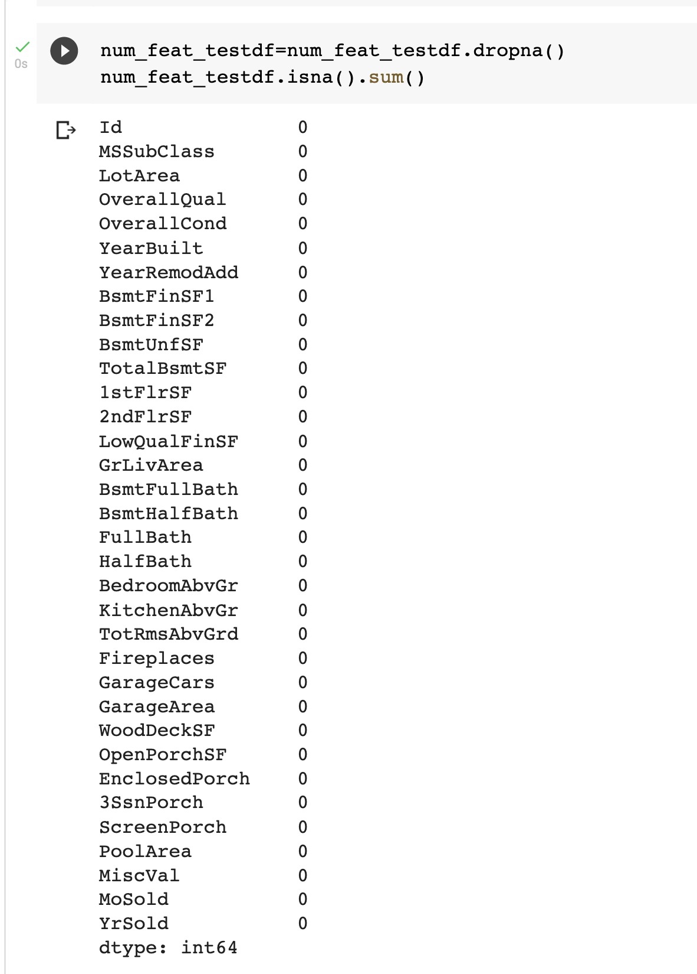
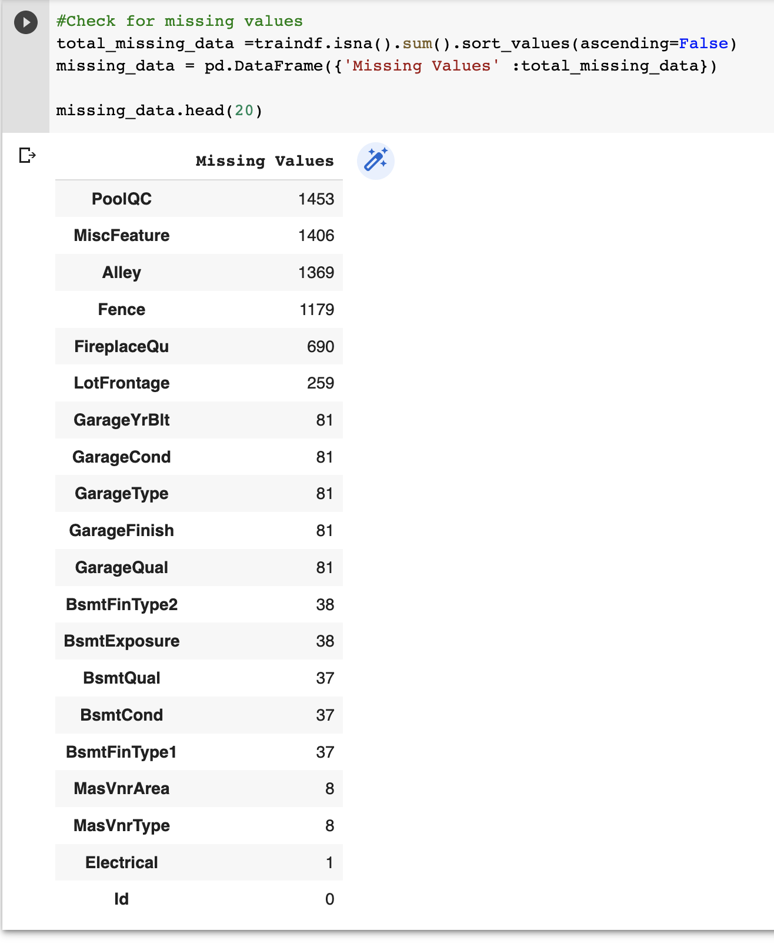
Checking for nas train and test df

Slide 4
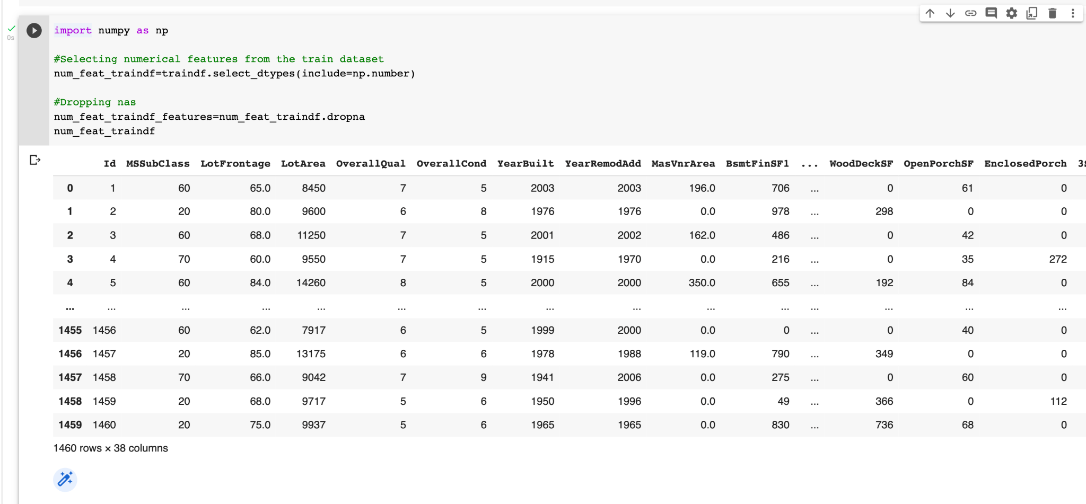
Selecting numerical features for traindf

Slide 5
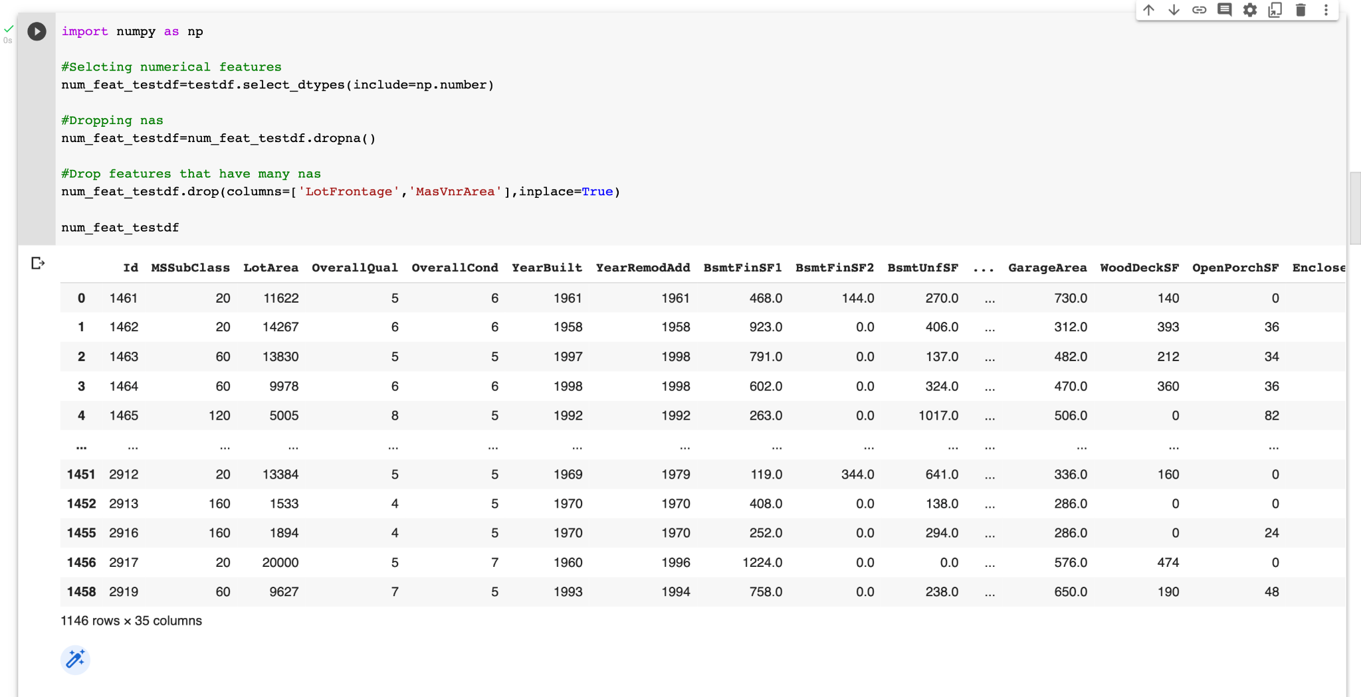
Selecting numerical features for testdf

Slide 6
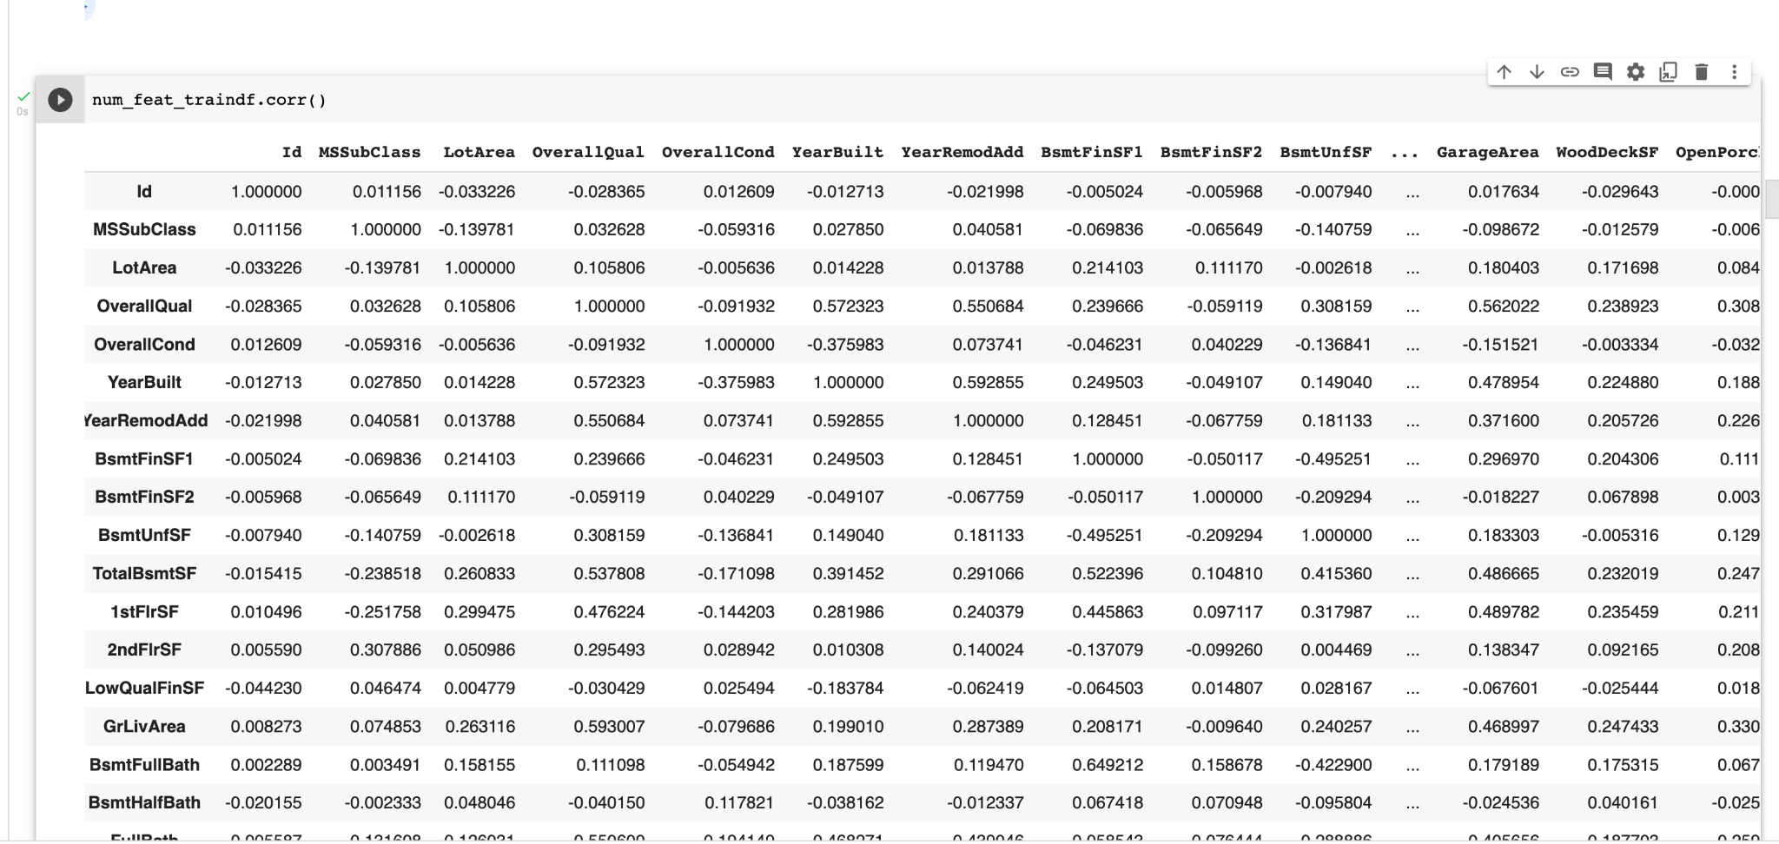
To find multicollinearity among features

Slide 7
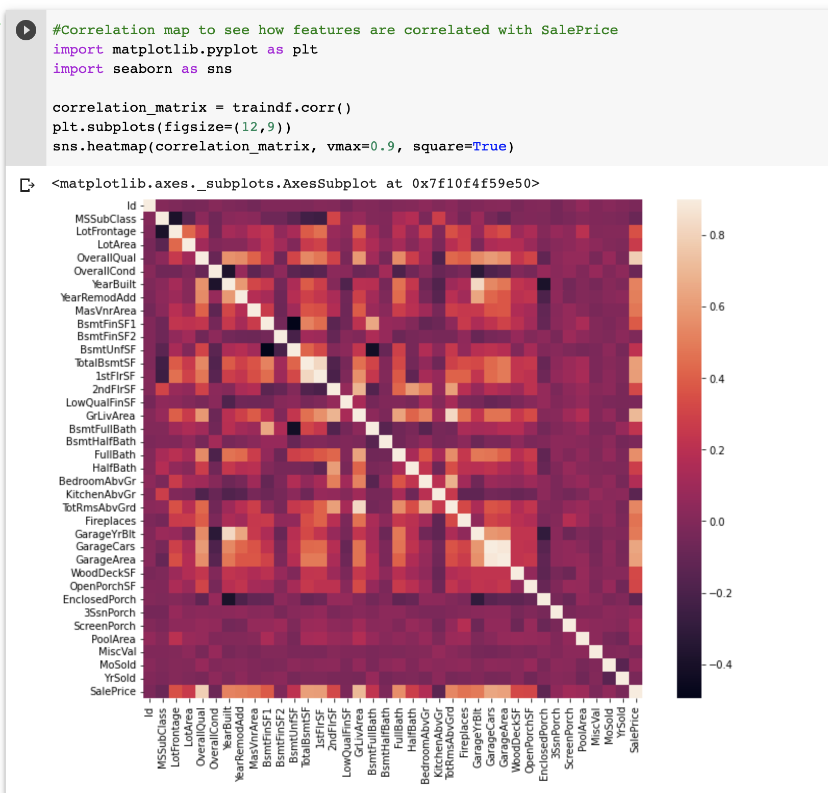
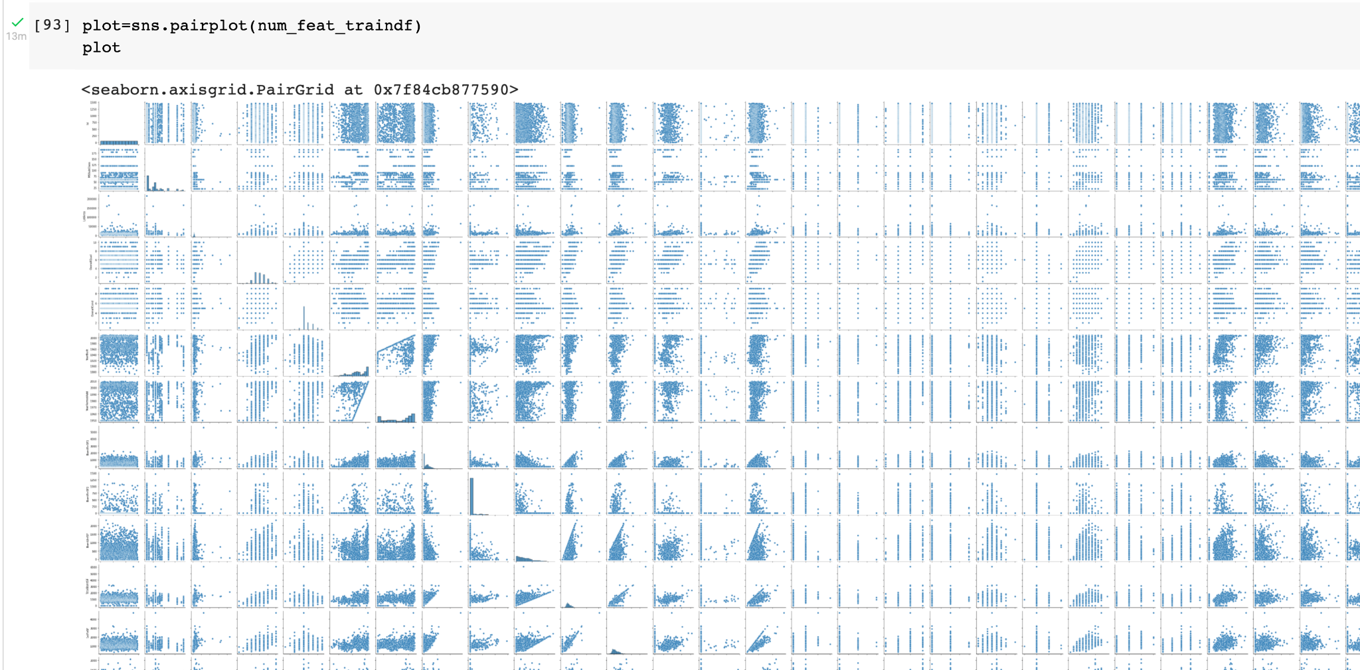
Correlation Heatmap

Slide 8
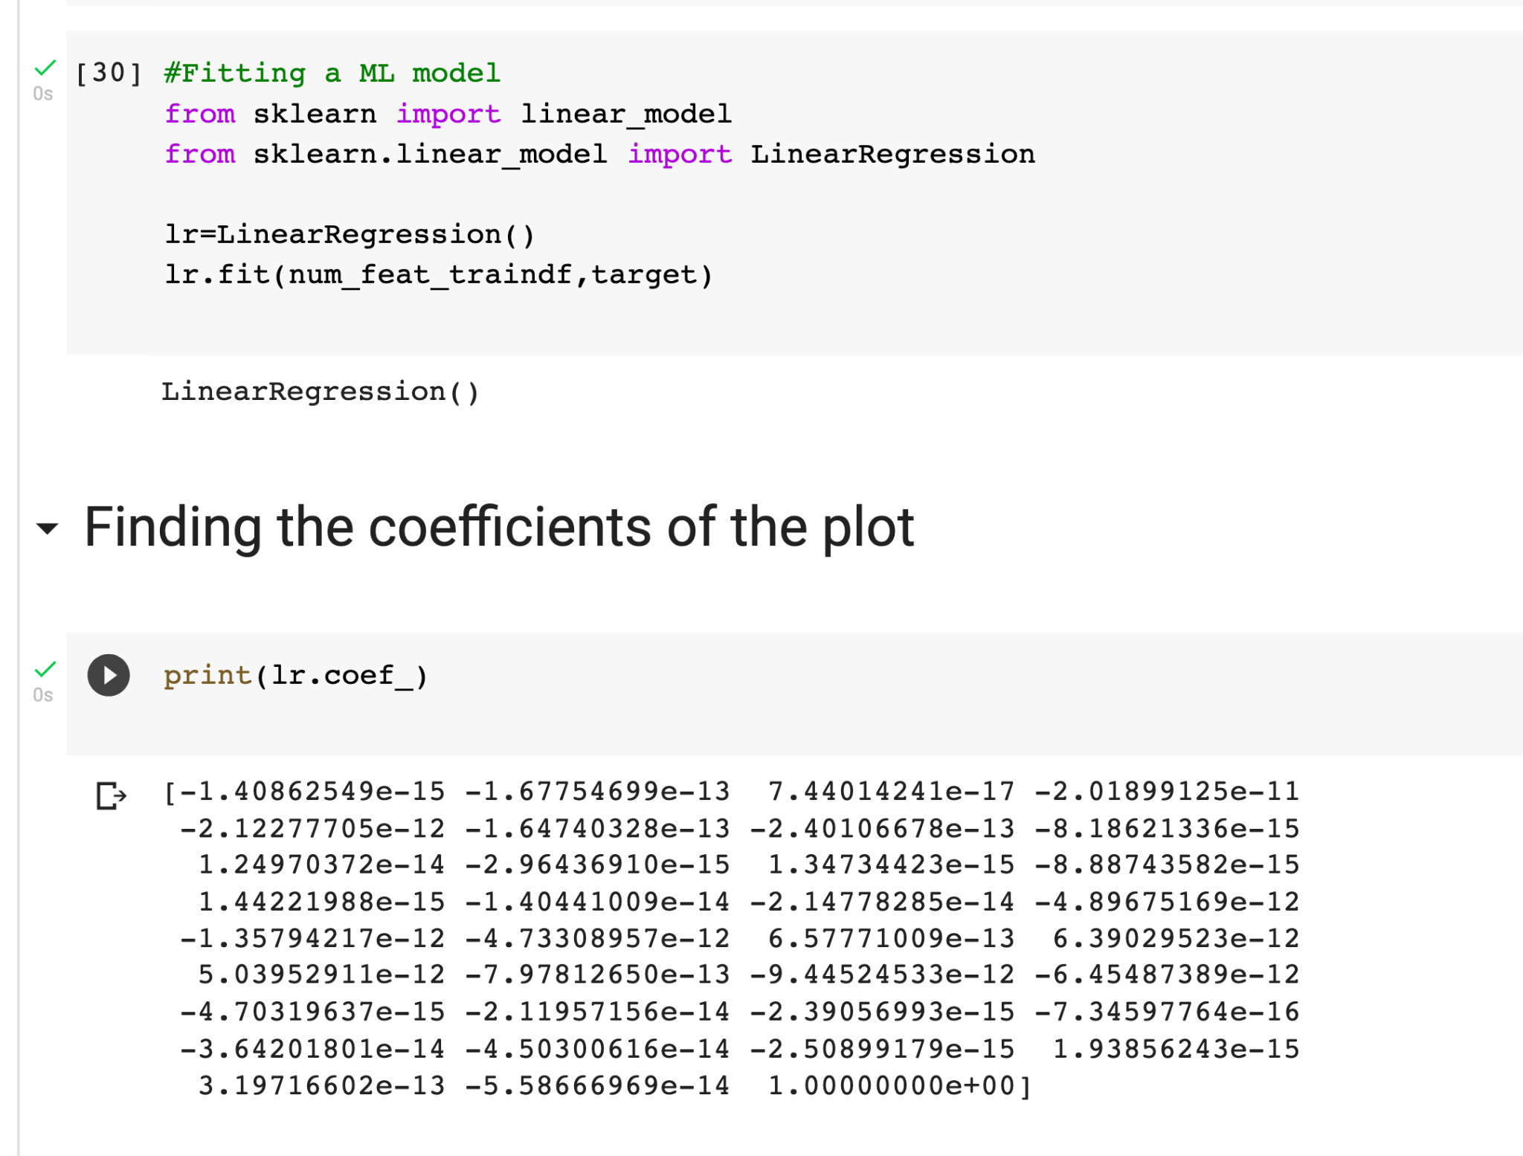
Fitting the linear regression model

Slide 9
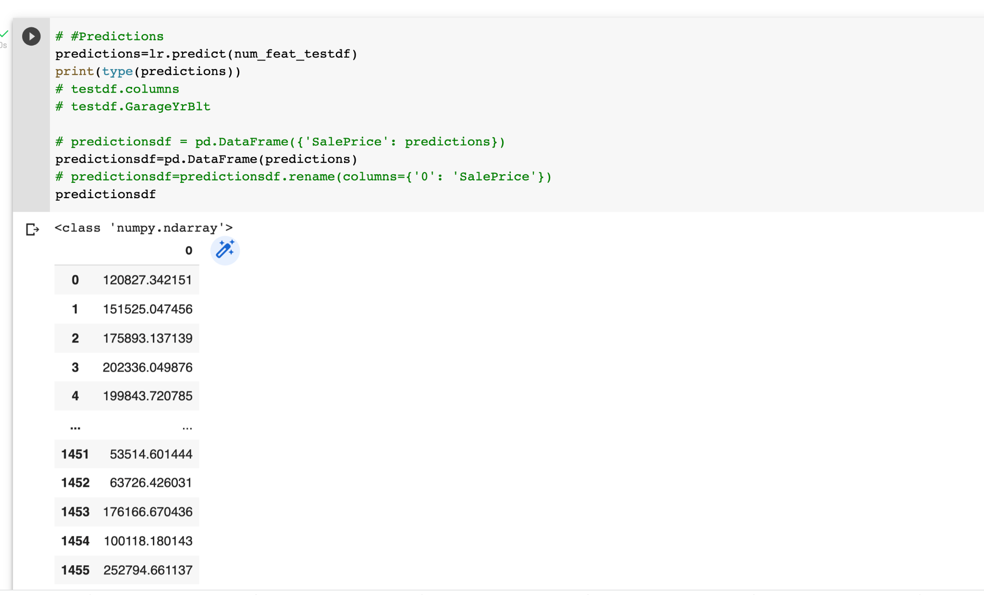

Slide 10
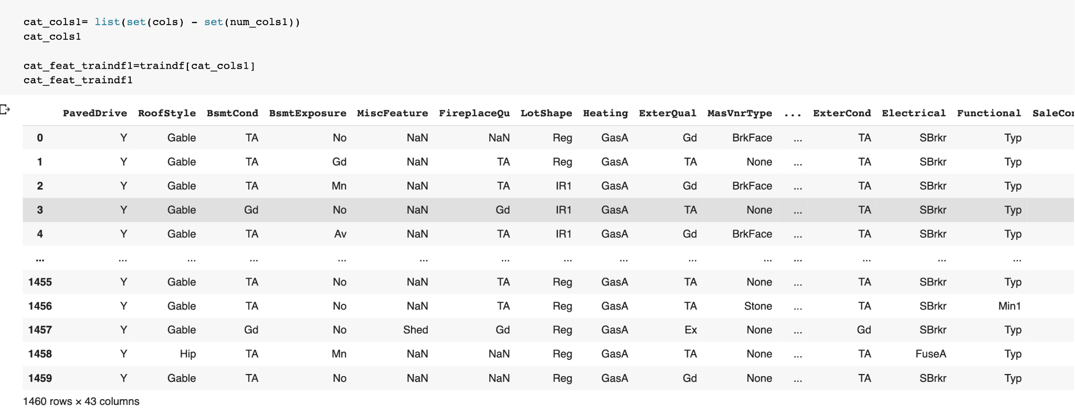
Categorical Features Dataframe

Slide 11
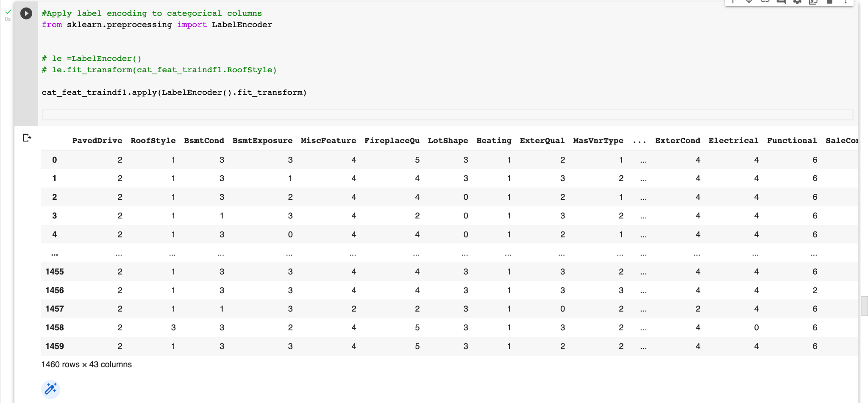
Label Encoded features

Slide 12
